Slide 1
POSIX AND SYSTEM –V SEMAPHORES’S
Presented by:
V Vijay

Slide 2
CONTENTS:
* INTRODUCTION OF IPC
* SYSTEM-V SEMAPHORES
* POSIX SEMAPHORES
* COMPARISION OF SYSTEM V SEMAPHORES AND POSIX SEMAPHORES
* LIMITATIONS OF SEMAPHORES
* REFERENCES

Slide 3
INTRODUCTION TO SEMAPHORES
No two processes can directly exchange/share the data, they must need any one of the IPC mechanism.
They are two types of IPC mechanism’s:-
1.System call based IPC mechanism.
2.Posix IPC mechanism(library functions based IPC mechanism).

Slide 4
WHAT IS SYSTEM -V SEMAPHORES ?
The semaphores is a synchronisation mechanism used in between
IPC shared memory and threads.
1. A semaphores contains counter used to access the multiple object files . This semaphores sets are identified by a key.
2. Semaphores is one of process utility technique in shared memory
3. The semaphores internally maintains a structure which is identified by kernel i.e, semid_ds
4. When this call is success , some of the semid_ds structure members are initialized.

Slide 5
To perform these operation the semaphore need predefined functions
Struct semid_ds
buf
{
unsigned short sem_num;
Short sem_op;
Short sem_flg;
};
* sem_op:- goes negative it acts as a blocking state otherwise it is in operation mode.
*sem_num:- selection of counter for each process.

Slide 6
System –V semaphores
SYNTAX:
#include<sys/sem.h>
1)int semget(key_t key , int nsem, int flag);
Return: [success: “semaphore id” / Failure:”-1”]
2)int semop(int semid, struct sembuf semoparray[], size_t nops);
Return: [success:’0’ / failure:’-1’]
3)int semctl(int semid,int semnum,int cmd,union semnumarg);
Return:[success :’0’ / failure: ‘-1’]
Union semnum
{
int val;//SET_VAL
struct semid_ds *buf;//IPC_SET/IPC_STAT
unsigned short *array;//SET_ALL/GET_ALL
};

Slide 7
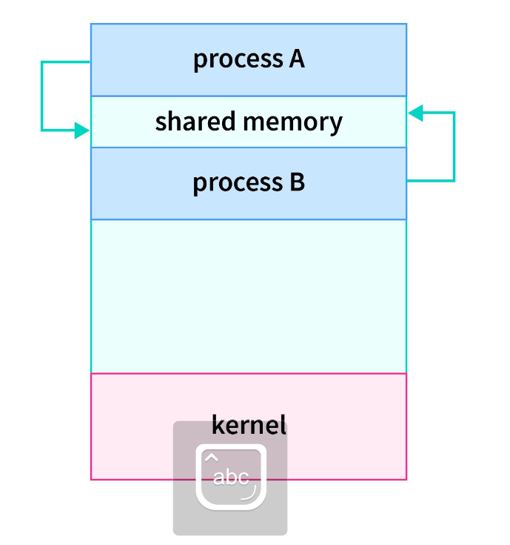

Slide 8
(SERVER)
#include<stdio.h>
#include<stdlib.h>
#include<sys/shm.h>
#include<sys/sem.h>
#include<fcntl.h>
#include<unistd.h>
#define KEY 0x11223344
Void main()
{
int shmid ,semid,ret;
char *ptr;
struct sembuf buf;
shmid=shmget(KEY,512,IPC_CREAT|0660);
if(shmid<0)
{
printf(“failed to create shared memory\n”);
exit(1);
}
semid=semget(KEY,2,IPC_CREAT|0666);
if(semid<0)
{
(client)
#include<stdio.h>
#include<stdlib.h>
#include<sys/shm.h>
#include<sys/sem.h>
#include<fcntl.h>
#include<unistd.h>
#define KEY 0x11223344
Void main()
{
int shmid ,semid,ret;
char *ptr;
Struct sembuf buf;
Shmid=shmget(KEY,512,0);
if(shmid<0)
{
printf(“failed to create shared memory\n”);
exit(1);
}
semid=semget(KEY,2,0);
if(semid<0)
{

Slide 9
{
printf(“failed to create semaphores\n”);
exit(3);
}
ret=semctl(semid,0,SETVAL,0);
ret=semctl(semid,1,SETVAL,0);
buf.sem_num=0;
buf.sem_op=-1;
buf.sem_flg=0;
ret=semop(semid,&buf,1);
ptr=shmat(shmid,NULL,0);
printf(“%s\n”,ptr);
strcpy(ptr+256,”hi”);
buf.sem_num=1;
buf.sem_op=1;
buf.sem_flg=0;
ret=semop(semid,&buf,1);
shmdt(ptr);
}
{
Printf(“failed to create semaphores\n”);
exit(3);
}
Ptr=shmat(shmid,NULL,0);
strcpy(ptr,”hello”);
buf.sem_num=0;
buf.sem_op=1;
buf.sem_flg=0;
ret=semop(semid,&buf,1);
buf.sem_num=1;
buf.sem_op=-1;
buf.se._flg=0;
semop(semid,&buf,1);
printf(“%s\n”,ptr+256);
shmdt(ptr);
}

Slide 10
POSIX SEMAPHORES
The semaphores is not IPC mechanism. Semaphores permits multiple processes to synchronise their actions. As it is similar to system –v semaphores but here we use predefined function for this operations.
They are two types of semaphores
1.Named semaphores.
2.unnamed semaphores.
1)Named semaphores:-
provides synchronisation between unrelated process and related process as well as between threads
kernel persistence
system wide and limited in number
uses sem_open

Slide 11
2)Unnamed semaphores:-
provides synchronization between threads and between related processes
threads_shared/process shared
uses sem_init
You should include a headerfile for posix:#include<semaphore.h>
1)int sem_init(sem_t *sem,int pshared,unsigned int value );
pshared argument indicates whether this semaphore is shared between threads process/between processes.
2)int sem_destroy(sem_t *sem);
Return[success:’0’/failure:’-1’].

Slide 12
Syntax:-for named type semaphores:
Header file:-#include<semaphore.h>
Sem_t* sem_open(const char*name ,int 0flag ,…..);
//(mode_t mode, unsigned int value)
Return:-[success: “address of pointer” / failure: “error”]
1st argument is file name along with path if it not in current working directory
2nd argument if it exist then there is no need to create its value is 0.
if the file not exit then use O_CREAT, O_RDWR,O_ RDONLY and O_EXCL. And also give read and write permissions for it.

Slide 13
Named semaphores as the following function:
1)sem_t * sem_open(const char*name,int 0flag);
>this function open/create a semaphore, initialize the semaphore.
Return:-[success: “address of file”/failure:”-1”].
2)sem_post(sem_t*sem);
Return:-[success:’0”/failure:”-1”].
>sem_open() increments(unlocks)the semaphore pointed to by sem.
The semaphores value consequently becomes greater than zero.
3:sem_getvalue(sem_t*sem);
>retrieves a semaphore current values

Slide 14
4.sem_close(sem_t*sem);
>close the semaphores
5.sem_unlink(sem_t*sem);
>remove semaphore name marks the semaphore for semaphore deletion
6.sem_wait(sem_t*sem);
>locking the semaphore

Slide 15
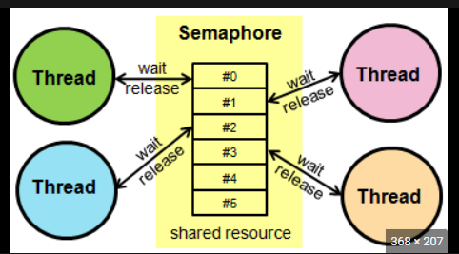
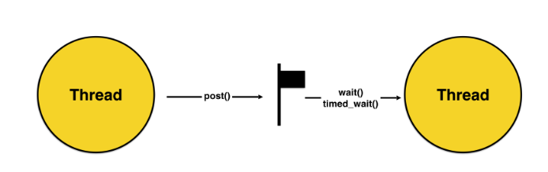

Slide 16
#include <stdio.h>
#include <pthread.h>
#include <semaphore.h>
#include <unistd.h>
sem_t mutex;
void* thread(void* arg)
{
wait sem_wait(&mutex);
printf(“just entered\n”);
sleep(4); //critical section sleep(4);
printf("\nJust Exiting...\n");
sem_post(&mutex);}
int main()
{
sem_init(&mutex, 0, 1);//based on 3rd argument the threads run at simultaneouly
pthread_t t1,t2;
pthread_create(&t1,NULL,thread,NULL);
sleep(2);
pthread_create(&t2,NULL,thread,NULL);
pthread_join(t1,NULL);
pthread_join(t2,NULL);
sem_destroy(&mutex);
return 0;
} //gcc 6.c -lpthread

Slide 17
Comparision between system v and posix semaphores
System -v semaphores
1.)In which you can control the counter can be increment/decrement
2.)System v allows to change the subset of original permissions
3.)While creating semaphore objects ,creates array of semaphores
Posix semaphores
1).The count value increment/decrement by1 value
2.)Posix semaphore not allows permission manipulation.
3).Posix semaphore need one variable.

Slide 18
Limitations of semaphores’s
1.Priority inversion ie,low priority processes gets into critical sessions and high priority processes keep waiting.
2.Operating system need to notify the waiting time and wake up time.
3.Proper handling of semaphore is necessary to avoid deadlock by accessing common variables.
4.Needed extra memory to store semaphore code

Slide 19
REFERENCES:
>greeksforgreeks
>www.kernel.org
>linux programming by Michael kerrisk
THANK YOU

Slide 20
ANY QUESTIONS?

